Slide 1
Particle Systems
Example with Mercury Particle Engine

Slide 2
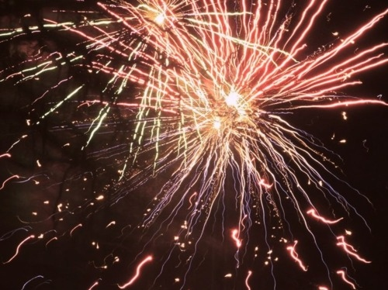
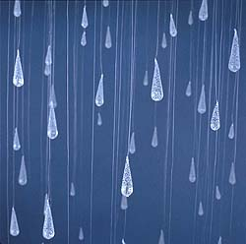
What is a particle?
A particle typically represents a single component in a particle effect. A single spark in a firework, a single element in a smoke plume, and a single flickering light in a magical effect are all examples of particles.

Slide 4
CPU or GPU bound
Uses the content pipeline to load

Slide 5
Particle Effect
Is a collection
Must be initialized to use

Slide 6
Your presentation
Demo the game
Show and tell how you are applying the constrains
Might invite other people to see your games

